Slide 1
Inventor iLogic-Vault | Quickstart Library
Markus Koechl
Solutions Engineer PDM|PLM – Autodesk Central Europe

Slide 2
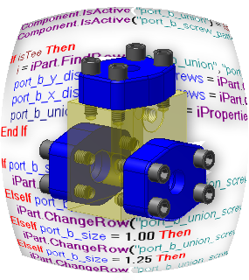
Agenda
iLogic-Vault Quickstart Library – Features | Benefits | Content
Get Started
iLogic-Vault Interaction – General Workflow
Setup Your Inventor iLogic-Vault Environment
Download Options
iLogic-Vault Quickstart Library – Application Sample
Dynamic iLogic Form – Fill Selection List by Search Result(s)
Download Selected Component

Slide 3
iLogic-Vault Quickstart Library | Features & Benefits

Slide 4
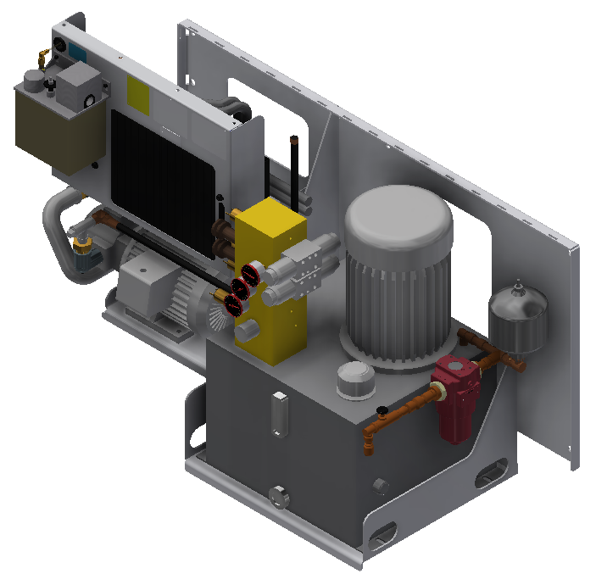
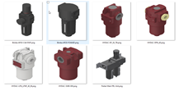
iLogic Vault | Features
Enable Rule – Vault Interactions
Search files in Vault by one to many property-value pairs
Supports AND | OR conditions for multiple search criteria
Get latest file(s) by Vault path for rule consumption
Get latest files from Vault as a search result for rule consumption
Check-Out / Check-In / Undo Check-Out

Slide 5
iLogic Vault | Benefits
Continue Using Known iLogic Rule Syntax
Classic & Manage Components approach
Identify matching components by search criteria
File naming independency
File path independency
Create “Dynamic” variant definitions
Fill iLogic variant selections by search results
Add new derivates to Vault and skip source template changes

Slide 6
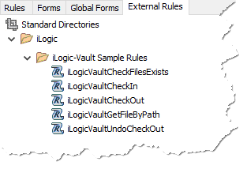
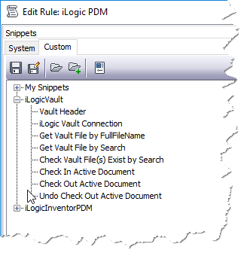
iLogic-Vault | Content
iLogic application extension „QuickstartiLogicLibrary.dll“
Sample rule for each function
Snippet library to quickly reuse function calls

Slide 7
iLogic-Vault Interaction | General Workflow

Slide 8
Workflow | iLogic-Vault Interaction
Reference: iLogic-Vault Extension
Get Vault Connection
iLogic-Vault Search, Download, Check-Out, …
…iLogic requires a file..
…continue using common syntax…

Slide 9
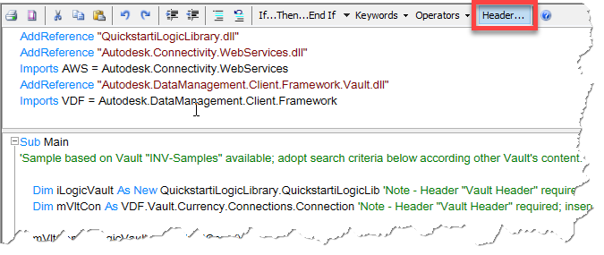
Workflow | iLogic-Vault Interaction
Reference: iLogic-Vault Extension

Slide 10
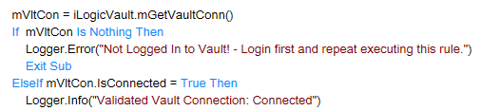
Workflow | iLogic-Vault Interaction
Reference: iLogic-Vault Extension
Get Vault Connection

Slide 11
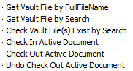
Workflow | iLogic-Vault Interaction
Reference: iLogic-Vault Extension
Get Vault Connection
iLogic-Vault Functions

Slide 12
Setup Your Inventor iLogic Environment

Slide 13
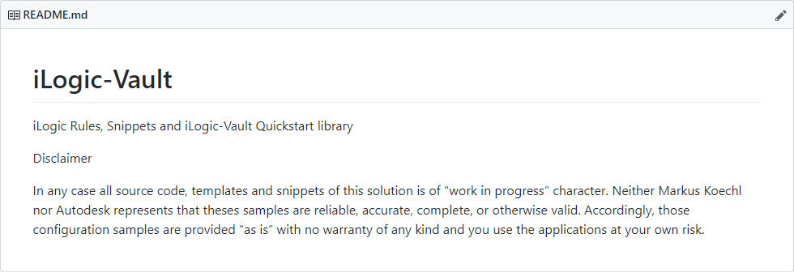
iLogic Vault | Download Options
ReadMe
Download Library
iLogic-Vault Library
Code Snippets
Sample Rules
Download Development Project and Sources – GitHub

Slide 14
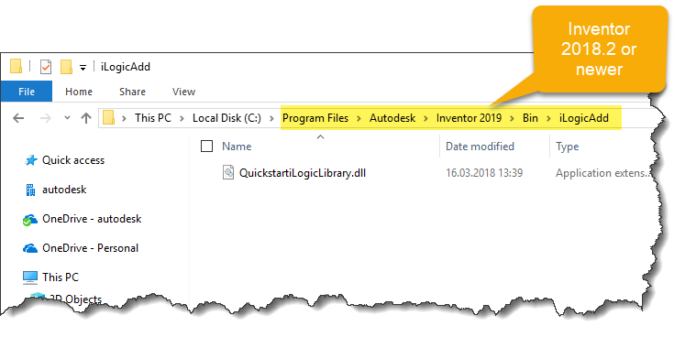
Add Library Extension
Copy QuickstartiLogicLibrary.dll to iLogic default extension folder

Slide 15
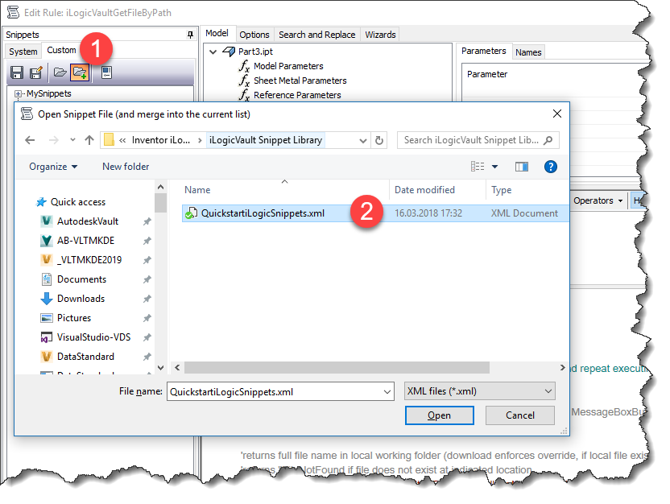
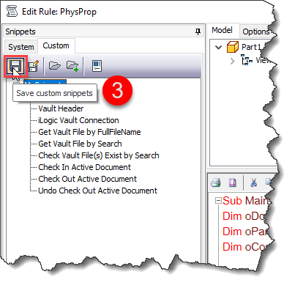
Add iLogic-Vault Snippet Library
Add/Merge snippets into your existing library
Don‘t forget to save ☺

Slide 16
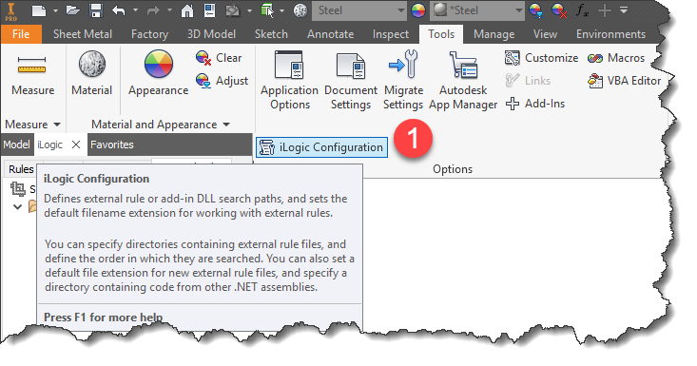
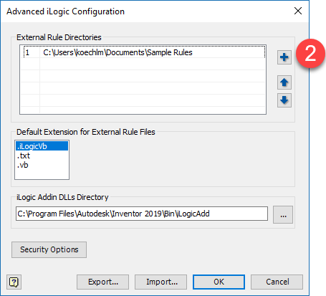
Add Samples
Configure External Rules directory

Slide 17
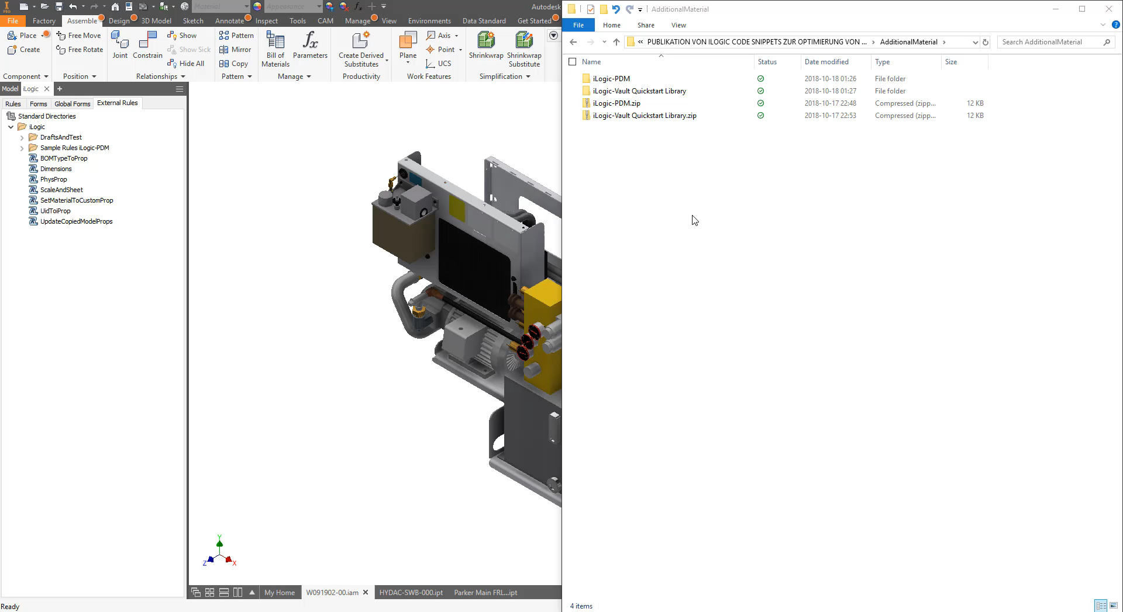
iLogic-Vault Quickstart Library | Installation

Slide 18
iLogic-Vault | Application Sample

Slide 19

iLogic 2019 | Application Sample
Filter-Types / Variants

Slide 20
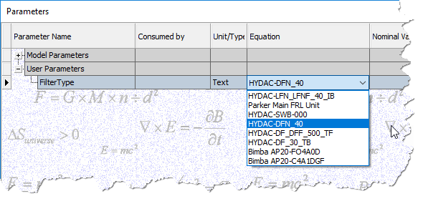
Workflow iLogic – No Vault Interaction
Static Selection List of Filters

Slide 21
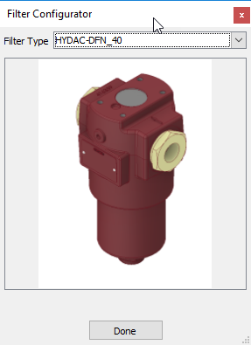
Workflow iLogic – No Vault Interaction
Static Selection List of Filters
Select Filter

Slide 22
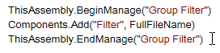
Workflow iLogic – No Vault Interaction
Static Selection List of Filters
Select Filter
Insert Filter

Slide 23
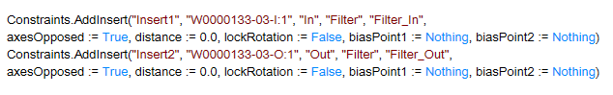
Workflow iLogic – No Vault Interaction
Static Selection List of Filters
Select Filter
Insert Filter
Apply Constraints

Slide 24
iLogic-Vault | Application Sample
Filter-Types / Variants

Slide 25
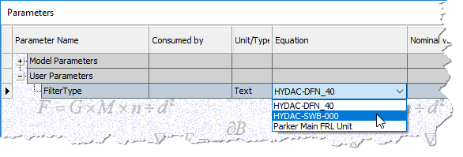
Workflow iLogic – Using Vault Interaction
Current Selection List

Slide 26
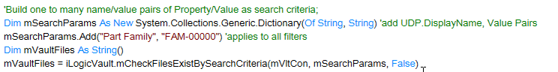
Workflow iLogic – Using Vault Interaction
Current Selection List
Update Selection List by Filters Available in Vault

Slide 27
Workflow iLogic – Using Vault Interaction
Current Selection List
Update Selection List by Filters Available in Vault
Select Filter

Slide 28
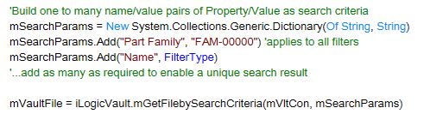
Workflow iLogic – Using Vault Interaction
Current Selection List
Update Selection List by Filters Available in Vault
Select Filter
Get Latest Revision of Filter

Slide 29
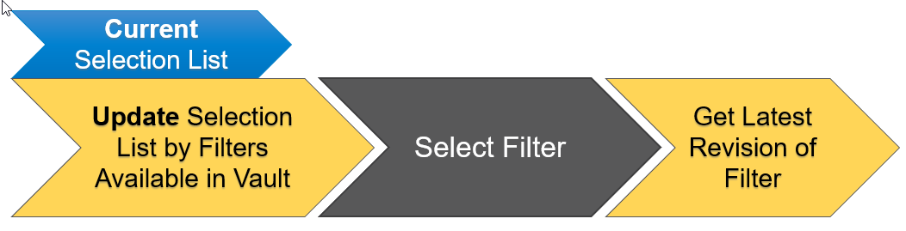
Workflow iLogic – Using Vault Interaction
Insert Filter

Slide 30
Workflow iLogic – Using Vault Interaction
Insert Filter
Apply Constraints

Slide 31
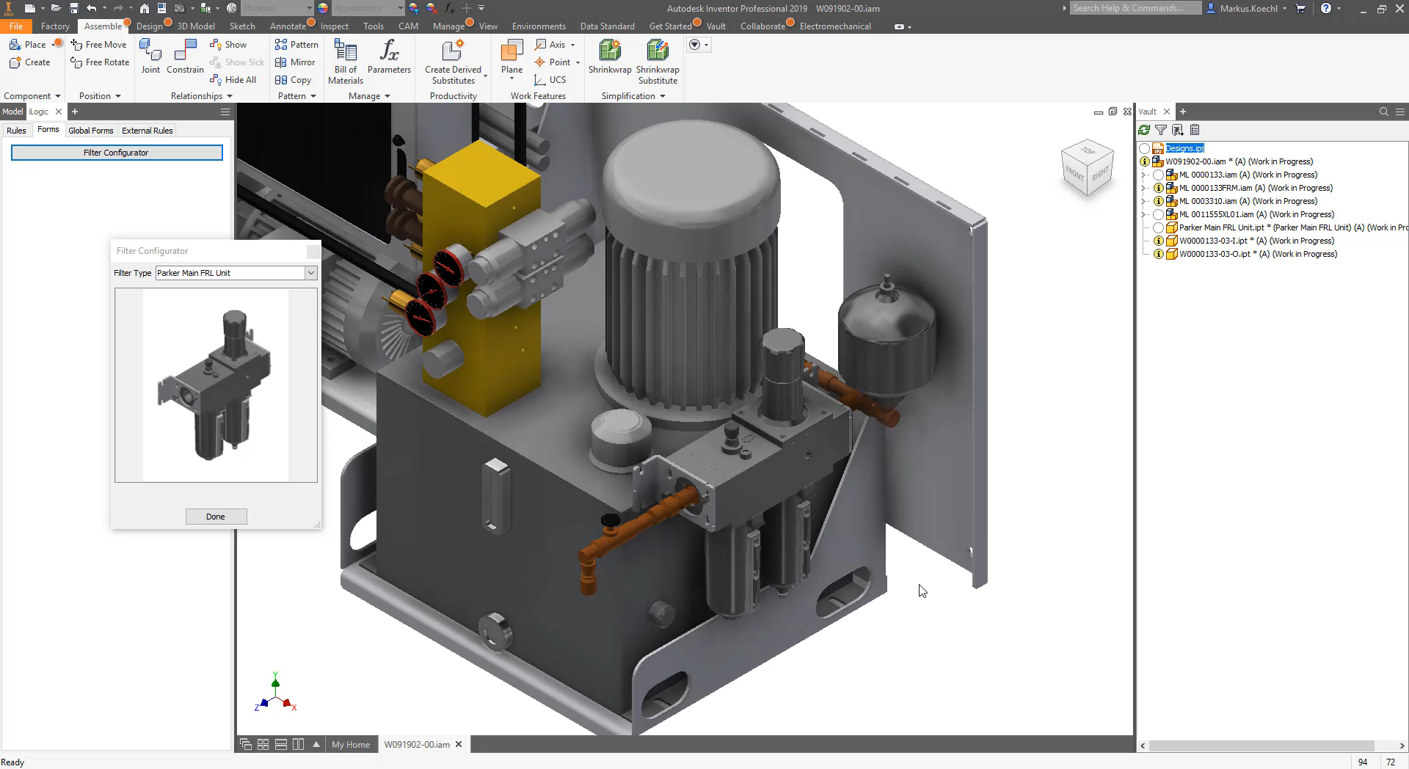
Workflow iLogic – Using Vault Interaction

Slide 32
Tips & Tricks

Slide 33
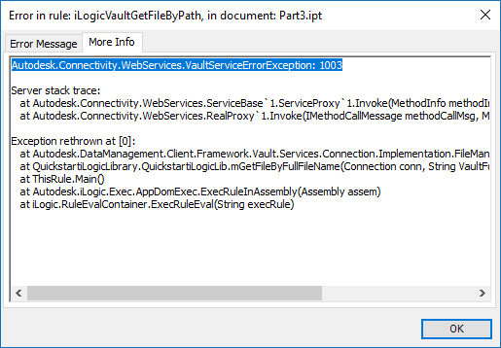
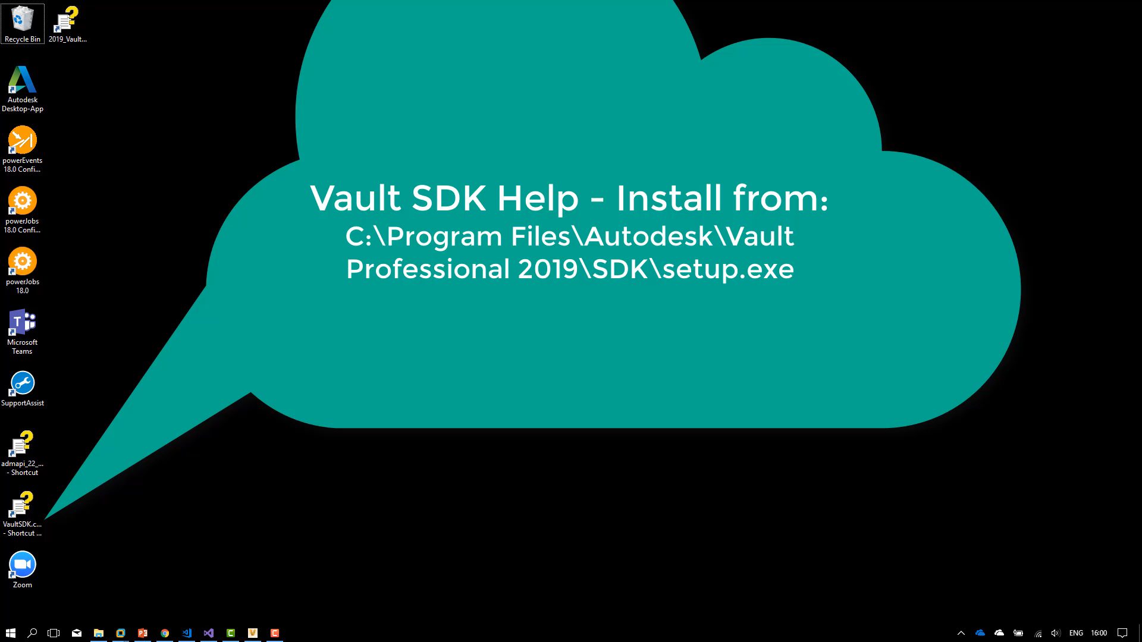
Lookup Vault Error Codes
What can you do if you encountered an error message from Vault?

